Slide 1
Machine Learning
Gradient Descent Algorithm
Linear Regression
Non-Linear Regression
Logistic Regression
Decision Trees
Regression Trees
Classification Trees
Clustering Algorithms
K-Means
Hierarchical clustering
DB-Scan
Mean Shift
GMM
Support Vector Machine
Deep Learning
MLP
CNN
Datasets
Breast Cancer Wisconsin
MIMIC-III
Framingham Heart Study
Alzheimer’s Disease Neuroimaging Initiative
Drug discovery
Microbiome

Slide 2
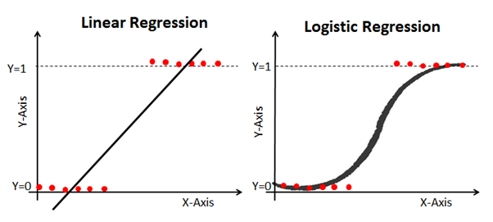
C3 – Logistic Regression
my humble ML course

Slide 3

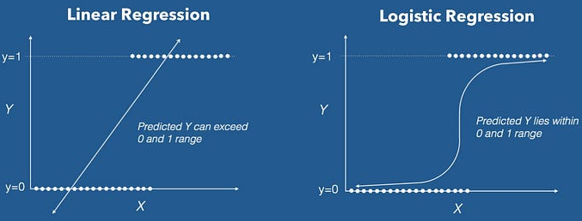
my humble ML course
Logistic Regression
supervised ML model & parametric classification model
transforms the linear regression function continuous value output into categorical value output using a sigmoid function.

Slide 4

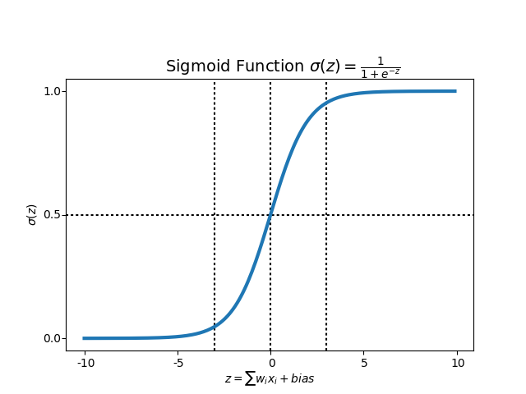

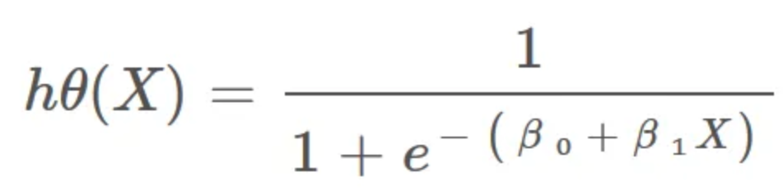
my humble ML course
Sigmoid function
.

Slide 5
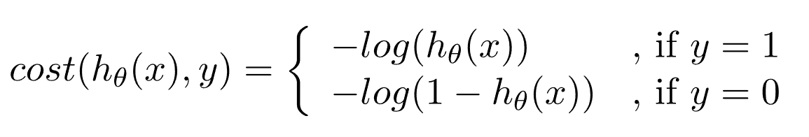
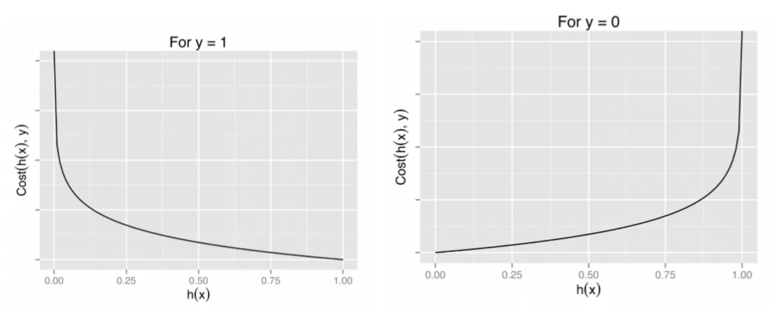
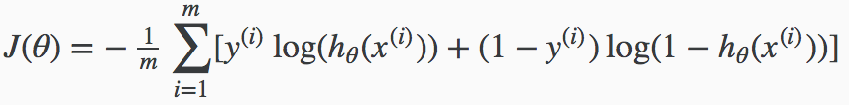
my humble ML course
Cost function
.

Slide 6
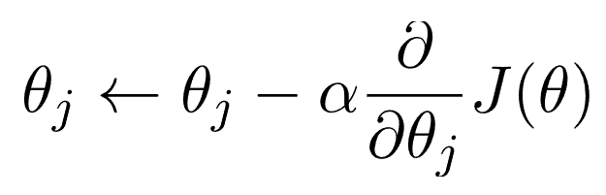
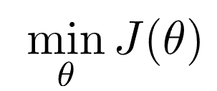
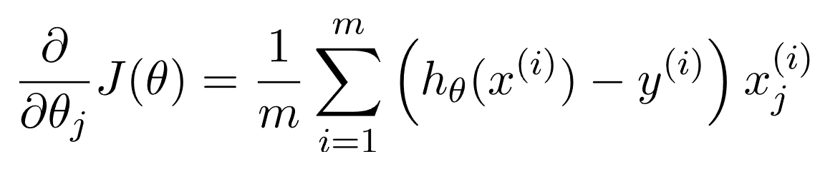
my humble ML course
Gradient descent
.

Slide 7
my humble ML course
Decision boundary
.

Slide 8
my humble ML course
Bibliography
https://www.geeksforgeeks.org/understanding-logistic-regression/
https://towardsdatascience.com/introduction-to-logistic-regression-66248243c148
https://towardsdatascience.com/logistic-regression-explained-9ee73cede081
https://polakowo.io/datadocs/docs/machine-learning/linear-models
https://stats.stackexchange.com/questions/278771/how-is-the-cost-function-from-logistic-regression-differentiated
https://math.stackexchange.com/questions/477207/derivative-of-cost-function-for-logistic-regression
https://www.baeldung.com/cs/gradient-descent-logistic-regression
https://es.wikipedia.org/wiki/Hiperplano
https://www.youtube.com/watch?v=-agtfqYimis
https://www.kamperh.com/data414/
https://towardsdatascience.com/logistic-regression-and-decision-boundary-eab6e00c1e8
https://medium.com/analytics-vidhya/decision-boundary-for-classifiers-an-introduction-cc67c6d3da0e

Slide 9




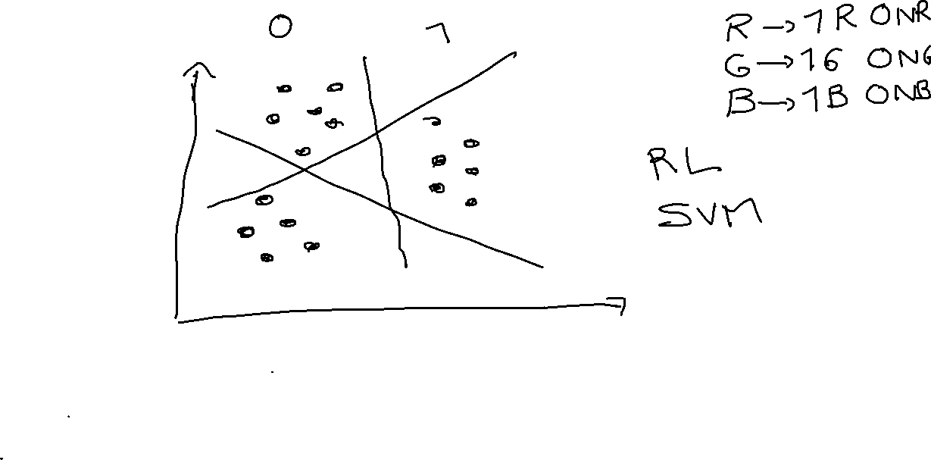

my humble ML course
Notes:
https://github.com/kamperh/data414

Slide 10

my humble ML course
Code
Notes:
https://github.com/kamperh/data414

Slide 11
my humble ML course
<title>
TODO

